Slide 1

Movie Analysis
Shivam Singh

Slide 2
PROJECT BRIEF & APPROACH
The project focuses on analyzing various aspects of movies, including their genres, duration, languages, directors, and the relationship between budget and gross revenue. The primary goal is to gain insights into these factors using descriptive statistics and correlation analysis. Excel functions are employed to perform the analysis, leveraging statistical measures such as mean, median, mode, variance, standard deviation, and correlation coefficients.
Approach: Use Excel to analyze movie genres, duration, language, and directors, employing descriptive statistics and correlation analysis. Visualize data to explore trends and relationships, particularly between budget and gross revenue and getting descriptive statics.
EXCEL SOLUTION PERFORM LINK :- https://docs.google.com/spreadsheets/d/1dghTzH4wlepOK7wjjXNlvsgb_OY66TGP/edit?usp=sharing&ouid=117463697734528382914&rtpof=true&sd=true

Slide 3
INTRODUCTION
A
B
Movie Duration Analysis
Movie Genre Analysis
D
Director Analysis
C
Language Analysis
E
Budget Analysis

Slide 4
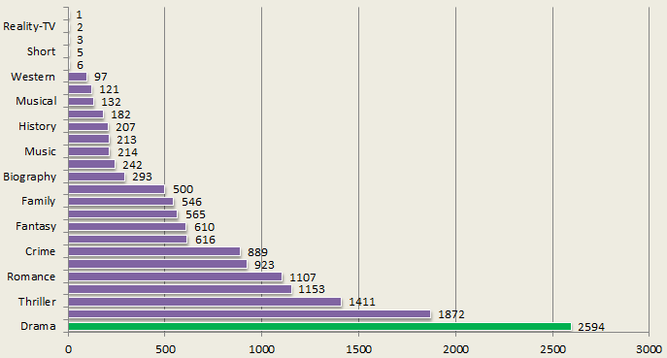
A. MOVIE GENRE ANALYSIS
Identify the most common movie genre in the dataset to understand its popularity and impact on IMDb ratings. Analyze descriptive statistics (mean, median, mode, range, variance, standard deviation).

Slide 5
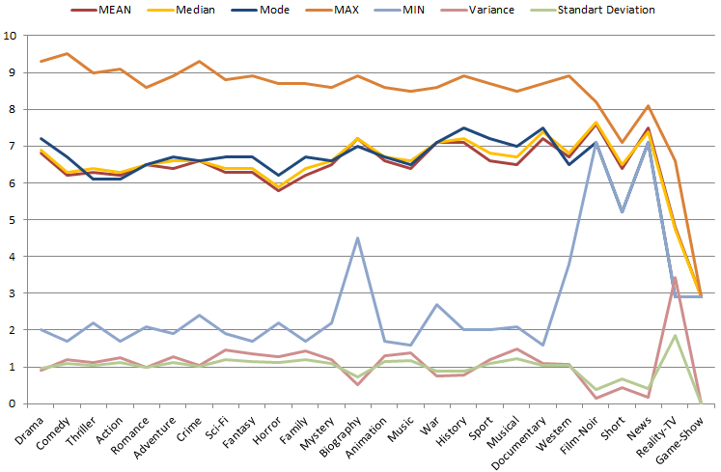
A. MOVIE GENRE ANALYSIS
In the descriptive analysis, we examined the mean and median of IMDb ratings and identified the mode. We observed that drama, comedy, sci-fi, and biography genres have some advantage on IMDb, with drama and comedy being particularly popular.

Slide 6
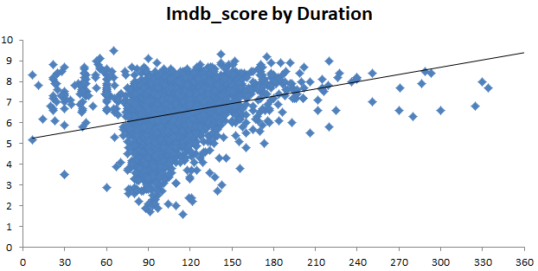
B. MOVIE DURATION ANALYSIS
Analyzing the impact of movie duration on IMDb scores using a scatter plot, we observe that movies with durations between 70-100 minutes have both high and low IMDb ratings, while those between 120-180 minutes tend to have higher average IMDb scores.

Slide 7
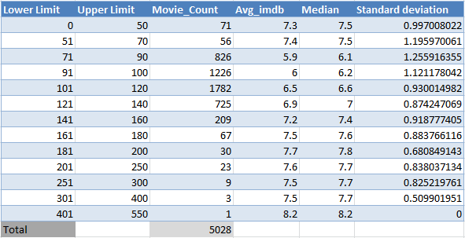
B. MOVIE DURATION ANALYSIS
In the second part, we analyze the number of movies and their durations using class distribution methods, and we calculate the mean, median, and standard deviation to evaluate the statistics.

Slide 8
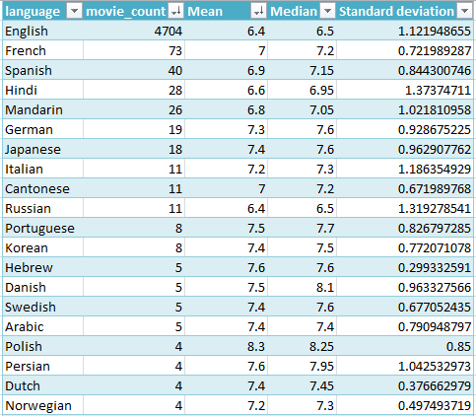
C. LANGUAGE ANALYSIS
In the language analysis, English is the most popular language with 4,704 movies, indicating that it is widely understood. This number is significantly higher than for other languages. Telugu and Polish have the highest IMDb scores, but with only 1 and 4 movies respectively, it's insufficient to assess their impact on IMDb ratings. Among languages with more than 10 movies, Japanese, German, and Italian have high IMDb scores.

Slide 9
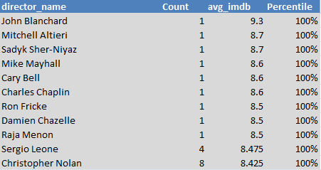
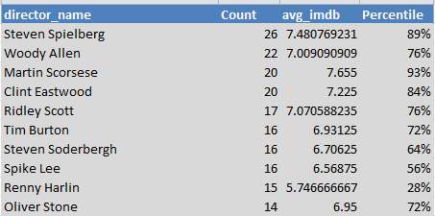

D. DIRECTOR ANALYSIS
Based on the average IMDb scores, this is the list of top directors who have achieved a 100th percentile ranking and the highest average IMDb ratings.
FUNCTION: COUNTIF, AVERAGEIF, PECENTRANK.EXC, PERCENTILE.INC
Based on the highest count movie, this is the list of directors. Where Martin Scorsese, Steven Spielberg maintain high percentile.
218 director has greater than 7.7 imdb which a great rating.

Slide 10
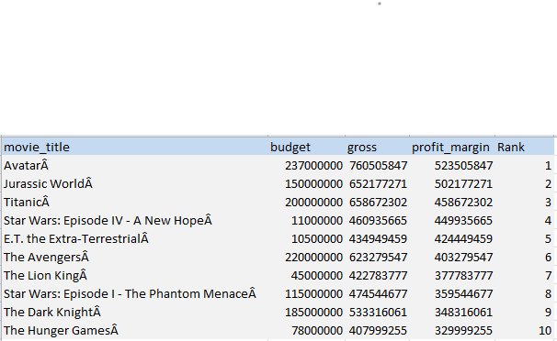
E. BUDGET ANALYSIS
The relationship between movie budgets and their financial success is analyzed by calculating the profit margin, which is the difference between the gross revenue and the budget. Here is the list of top movies by profit margins.
A correlation coefficient of 0.0966 between budget and gross earnings suggests a very weak positive correlation. The budget of a movie does not significantly predict its gross earnings, This means that there is a slight tendency for movies with higher budgets to have higher gross earnings

Slide 11
INSIGHTS & RESULT
The analysis reveals that while certain genres like drama and comedy are prevalent, their impact on IMDb scores varies. Movie duration moderately influences ratings, and language has little effect, though choosing popular languages can boost audience interaction. Some directors significantly impact IMDb scores, but high-budget films don't necessarily guarantee financial success or high ratings.
The project successfully analyzed various factors influencing IMDb movie ratings, including genre, duration, language, director impact, and budget. It deepened my understanding of how these elements correlate with movie success, revealing that while some factors like genre and director matter, others, like budget, are less predictive of high ratings.
We gained an advanced understanding of Excel implementation, descriptive statistics, and correlation analysis, utilizing multiple advanced functions to perform a comprehensive analysis.

Slide 12
THANK YOU

